Slide 1
Introduction
These templates have been developed to support the sponsorship sales process and to aid your conversations with potential sponsors.
We have developed a suite of four documents, which can be used as templates for all of your sales collateral including presentations for meetings.
Companies engage in sponsorship for a number of reasons and business objectives. Fundamentally, these fall into two categories:
Business to consumer (B2C) – i.e. reaching consumers and increasing awareness and sales/customer numbers (for example). Typical sponsors in these areas will be local retailers, restaurants, coffee shops, hairdressers, gyms and pubs
Business to business (B2B)– i.e. reaching businesses to increase a client base (for example). Typical sponsors include: banks/financial service providers, lawyers and accountants etc.
Therefore, we have created four documents, as follows:
A B2C Sponsorship Teaser, which can be used to make initial contact with potential sponsors and encourage them to have a further conversation or even a meeting
A B2C Sponsorship Deck, which can be used in first meetings, having sent through the teaser to secure a meeting. They can also be emailed after meetings to summarise the opportunity and introduce the club
A B2B Sponsorship Teaser, which can be used to make initial contact with potential sponsors and encourage them to have a further conversation or even a meeting
A B2B Sponsorship Deck, which can be used in first meetings, having sent through the teaser to secure a meeting. They can also be emailed after meetings to summarise the opportunity and introduce the club

Slide 2
Teaser - General Considerations
N.B. These recommendations apply to both B2C and B2B teasers.
A Teaser (or brief introductory document) should be short, concise and encourage potential sponsors into wanting to engage in further conversations with you. They are not intended to provide chapter and verse of the club and the sponsorship opportunity – successful sponsorships need the input from potential sponsors to ensure that their objectives are met.
The comments in the light-blue in boxes provide further information on constructing the perfect teaser.
Key Recommendations:
The teaser should be visually stimulating, so use the best appropriate photos of the club that you have (see below). If you don’t have good ones, perhaps you can get a volunteer to take some on matchday
It should summarise the opportunity and provide headline information on the club i.e. an outline your elevator pitch
It shouldn’t be longer than 10 slides – ideally fewer – and not too copy heavy – use the template as example for word count. If you wish, you can reduce the number of slides by combining slides 2 to 7 (on the template)
There should be a clear call to action i.e. organise a meeting or call to discuss this further
Further Considerations – Image and Font Selection
As per the template, you should use impactful images that represent the club in a positive light, so think about:
Using high-resolution images that aren’t blurry
Adapt the documents, so that they fit with your club’s colours
Capture the best of the club’s facilities
Where possible, consider photos that include a number of people (demonstrating the popularity of the club) i.e. from matchdays, minis trainings and/or club events/socials
The font you use should be consistent across all of your materials. If you have a club ‘house font’ use that but if not you can use the one included in the template. We have selected Montserrat, which is free to download here: https://fonts.google.com/specimen/Montserrat

Slide 3
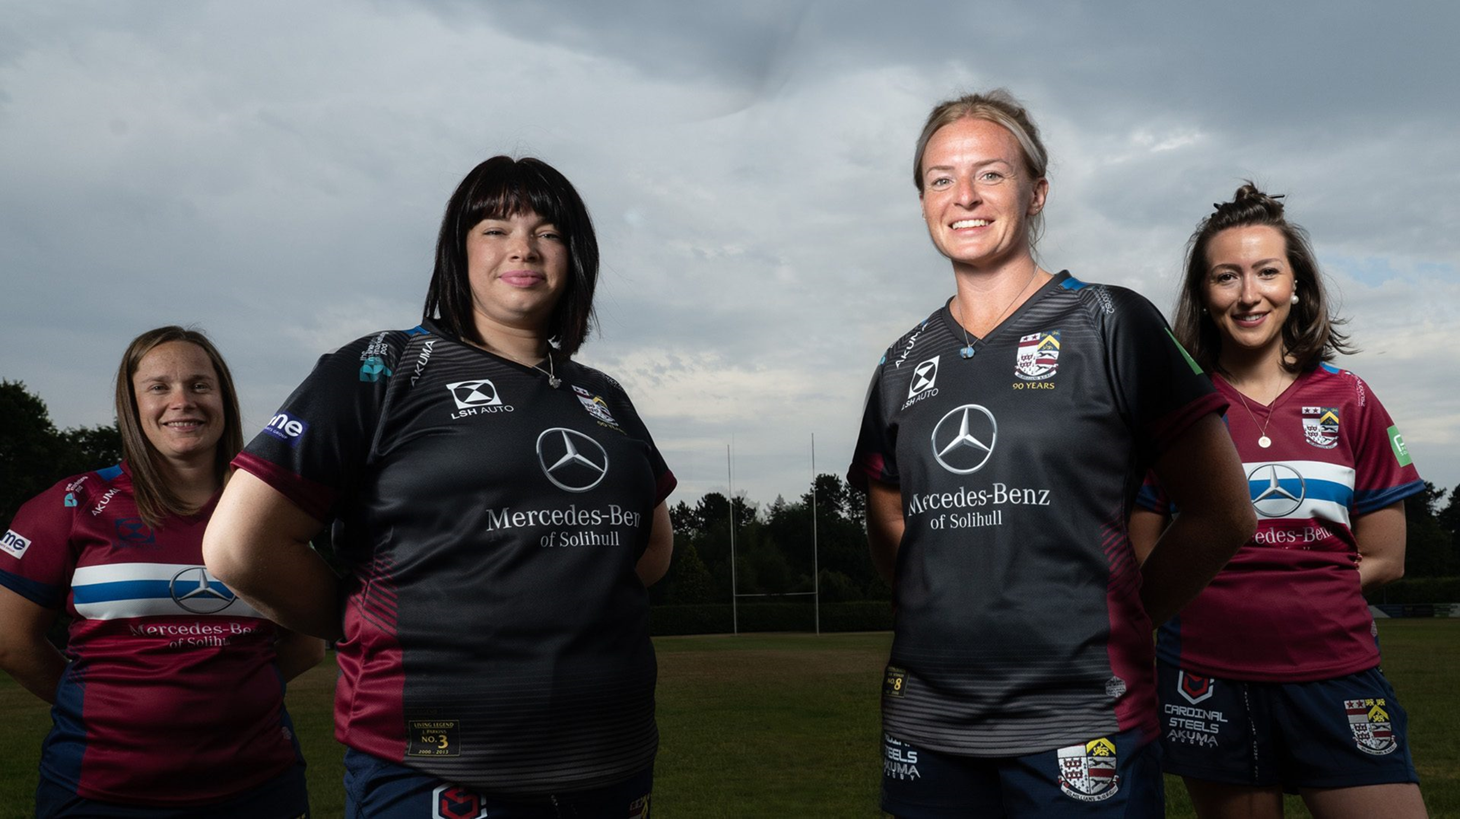
Insert Club Logo
Here
Insert Potential Sponsor Logo Here
(INSERT CLUB NAME)
COMMERCIAL PARTNERSHIPS 23/24
JOIN OUR PACK TO ACHIEVE YOUR BUSINESS OBJECTIVES

Slide 4
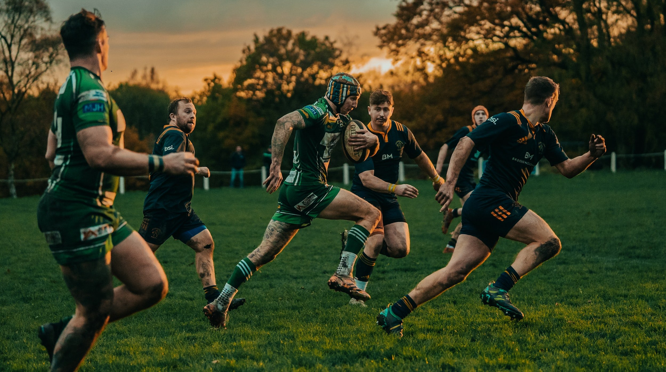
EVERY WEEK, OVER 300 LOYAL FANS, INCLUDING BUSINESSES, WATCH OUR MEN’S 1st TEAM
Change the image and copy as appropriate

Slide 5
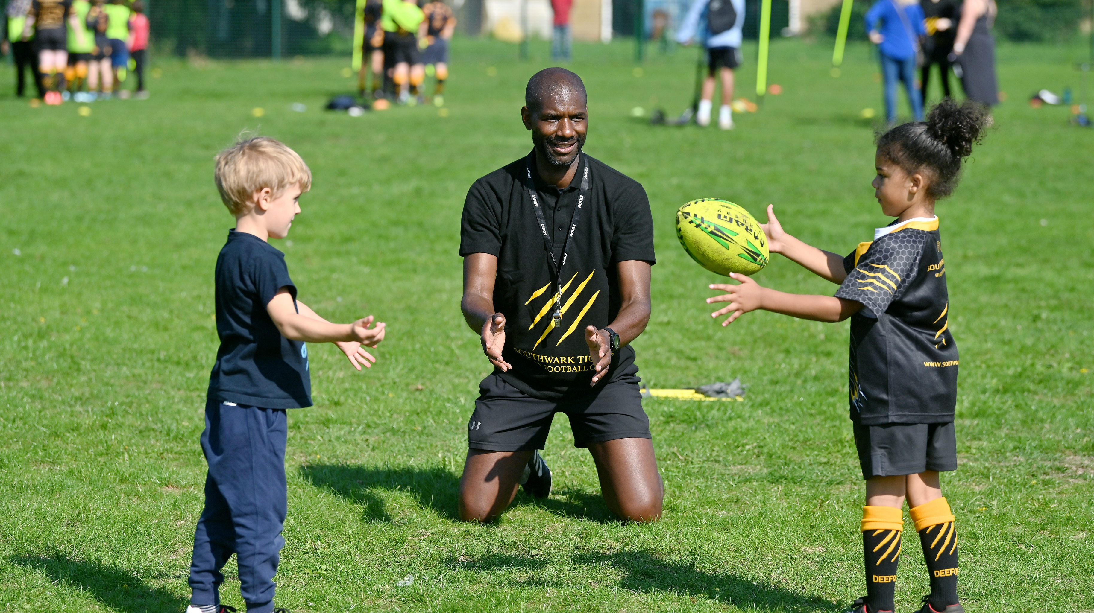
Change the image and copy as appropriate
OVER 700 KIDS AND THEIR PARENTS VISIT THE CLUB EVERY SUNDAY

Slide 6
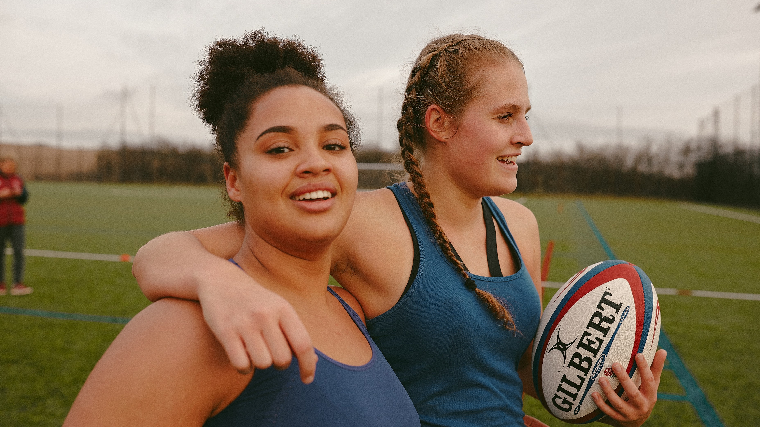
Change the image and copy as appropriate
A FAST GROWING WOMEN’S SECTION INCREASING AT 50% EVERY SEASON

Slide 7
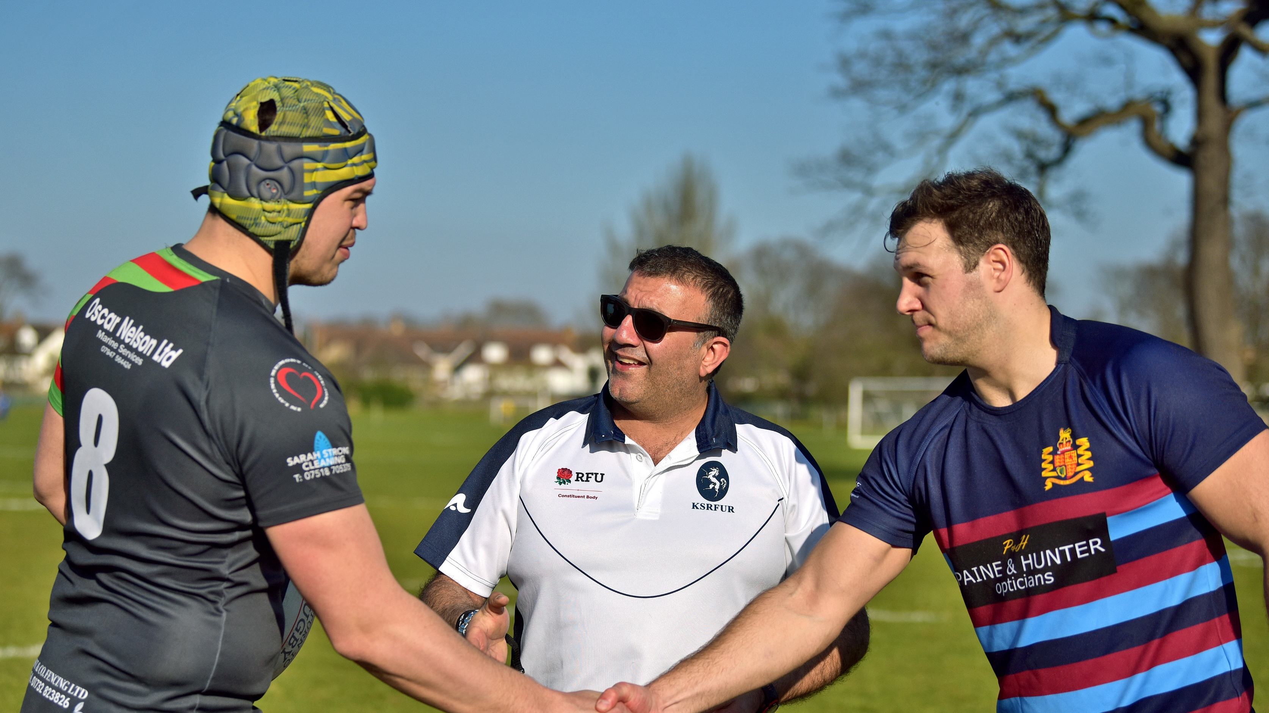
A GROWING NUMBER OF VOLUNTEERS, INCLUDING FROM LOCAL BUSINESSES
Change the image and copy as appropriate

Slide 8
REGULAR AND WELL ATTENDED CLUB NETWORKING/BUSINESS CLUB EVENTS
Change the image and copy as appropriate

Slide 9
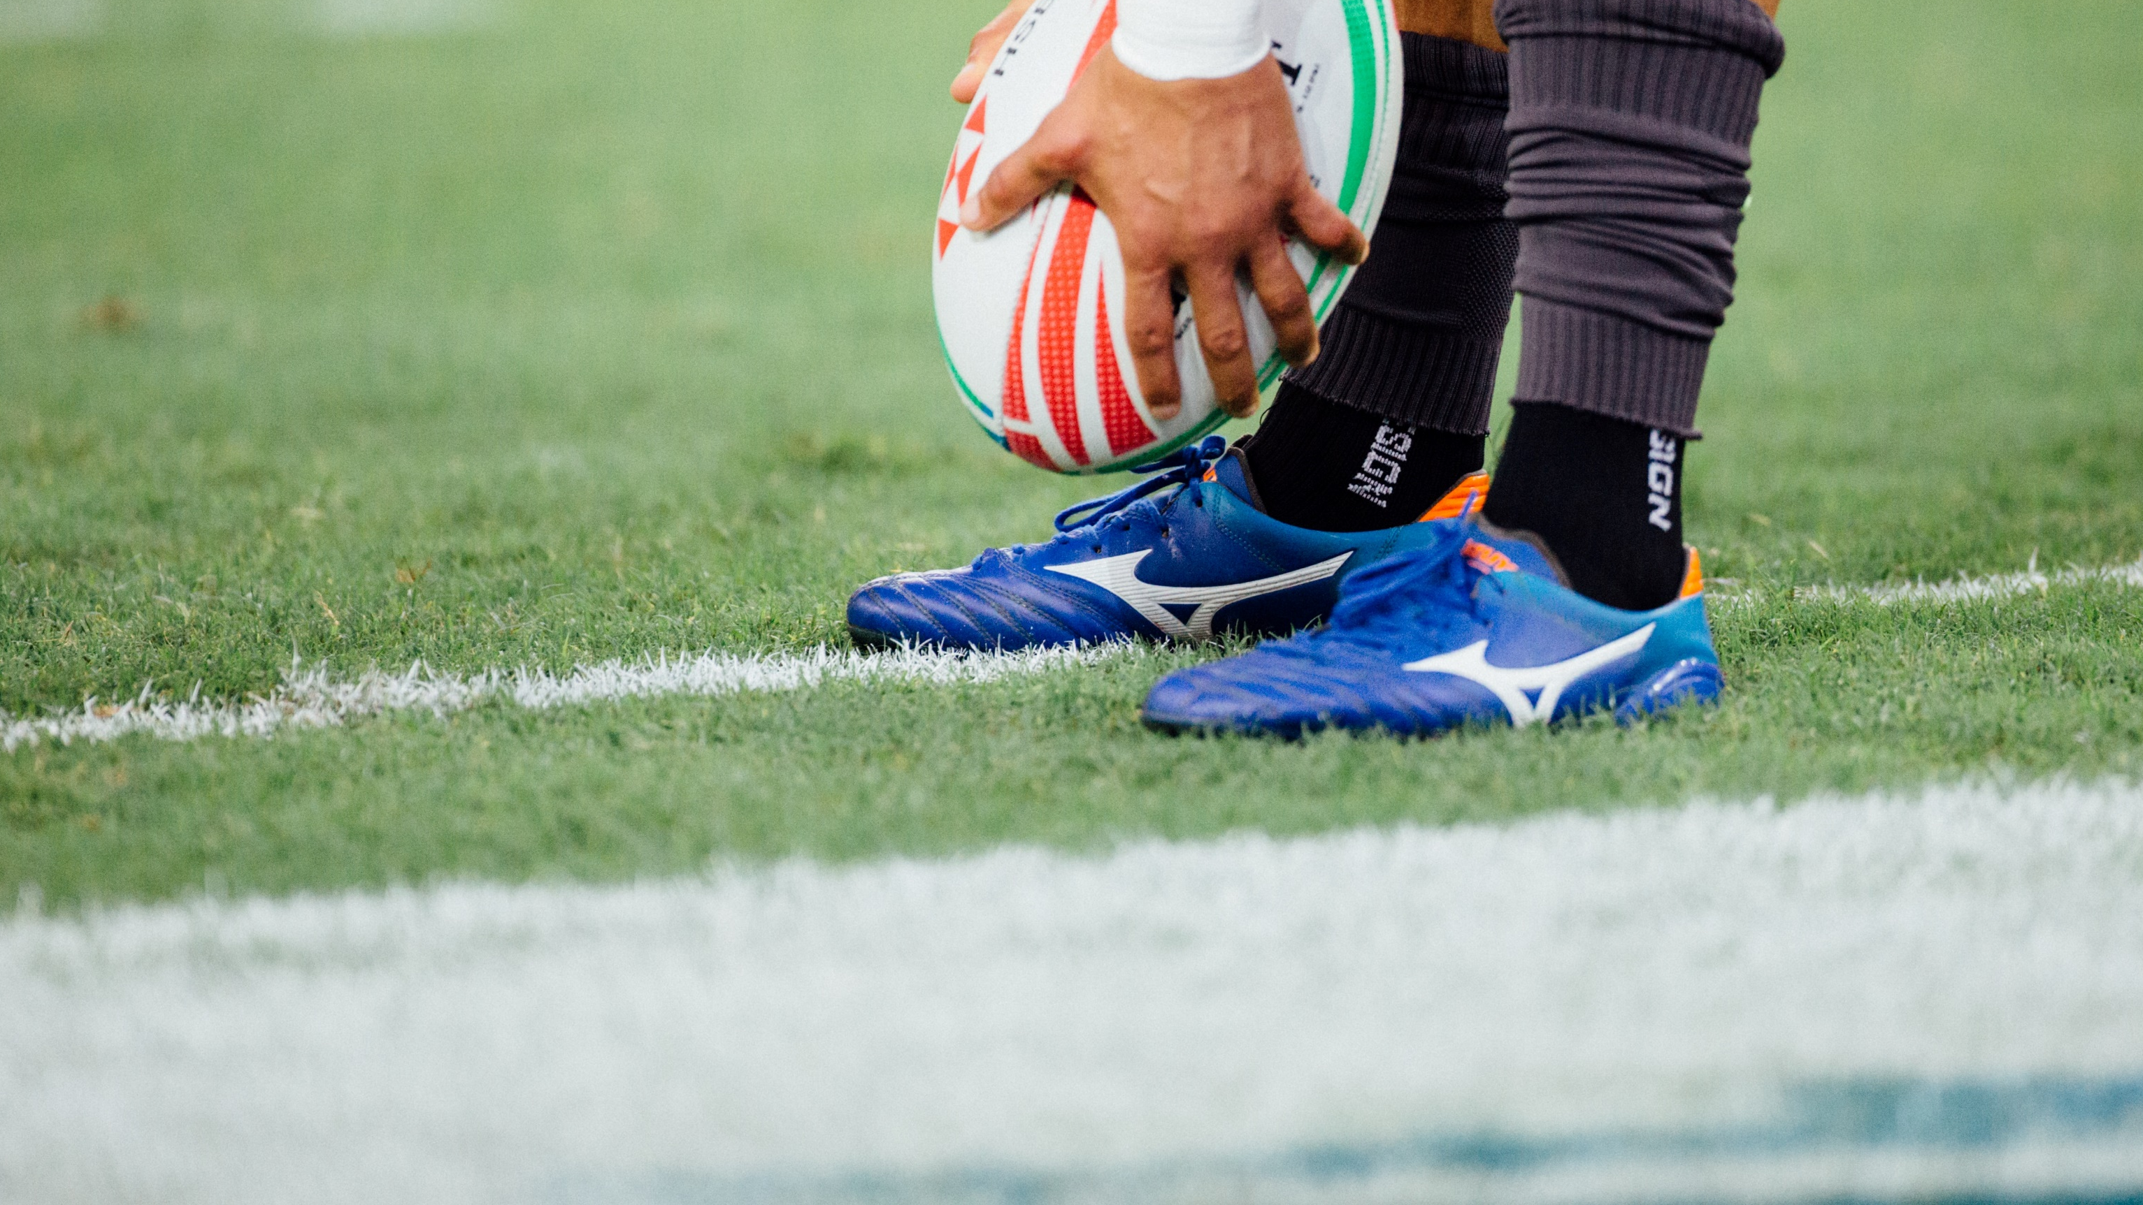
Change the image and copy as appropriate
PLAYING IN THE 3RD TIER OF THE ENGLISH RUGBY PYRAMID, WE ARE A CLUB FOCUSED ON DELIVERING RESULTS BOTH ON AND OFF THE FIELD

Slide 10
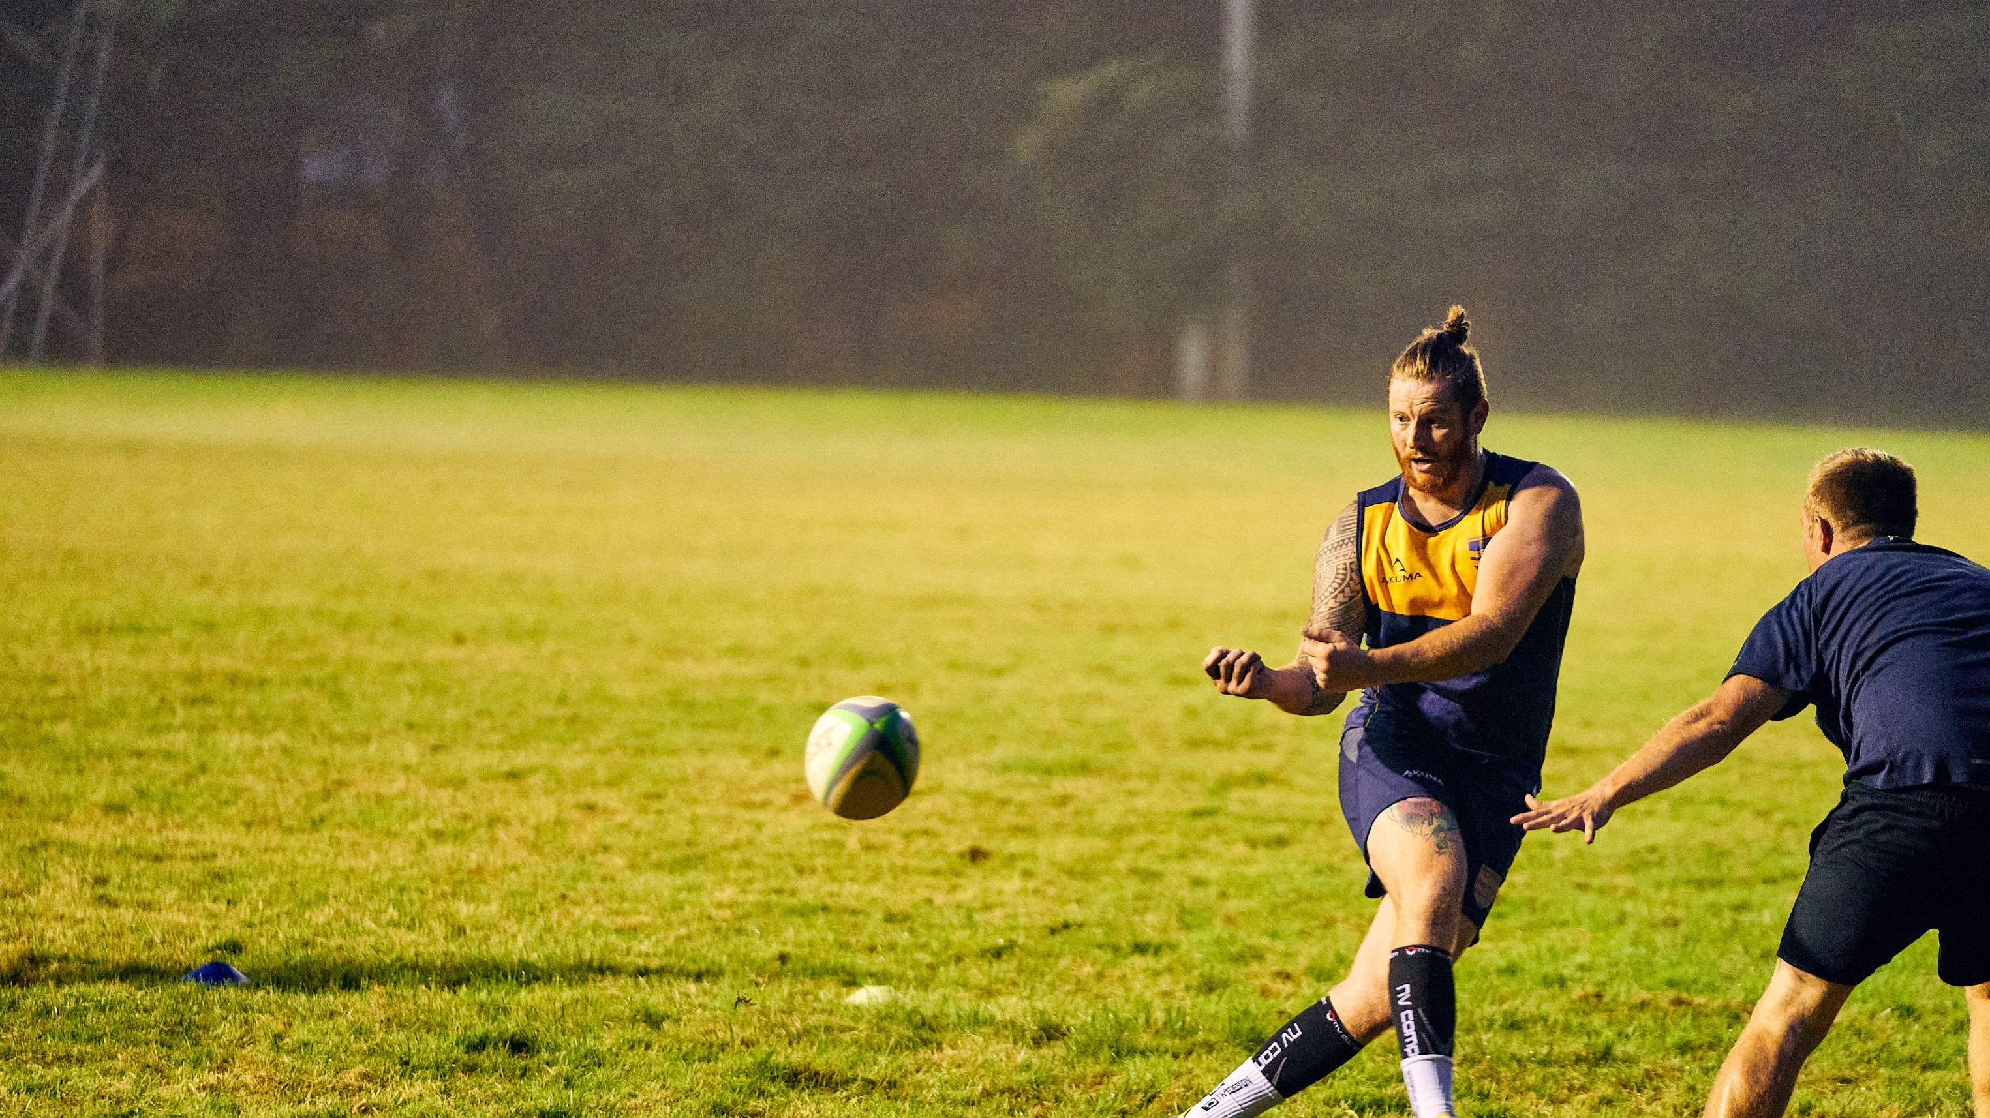
OUR AMBITION IS TO WORK WITH MAJOR BRANDS IN THE AREA WHO SHARE OUR VISION AND HELP GIVE THE COMMUNITY SOMETHING TO BE PROUD OF
Change the image and copy as appropriate

Slide 11
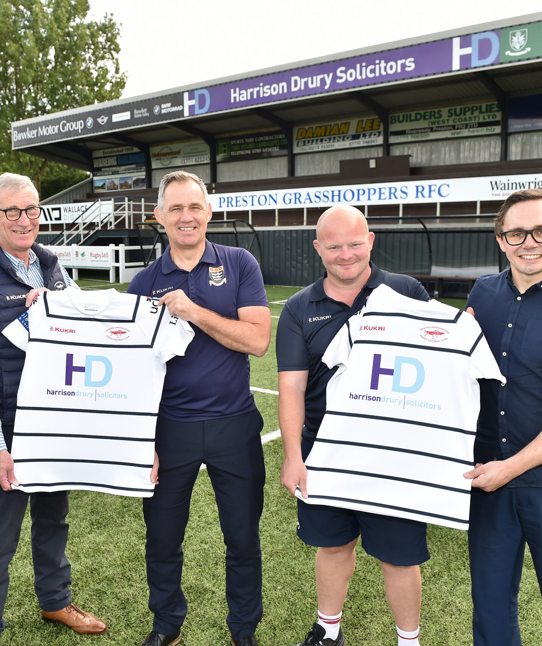
WHAT WE CAN DO FOR YOU
We are a club who respect local businesses and want to enhance the region as a centre for commerce.
We are looking to work with businesses who share the same vision, in terms of being driven by performance and becoming ambassadors for the area.
We can build a sponsorship that will really deliver against your short, medium and long-term objectives.
Consider who you’re meeting and whether they share the same values as you, especially across the community etc.
Include appropriate image

Slide 12
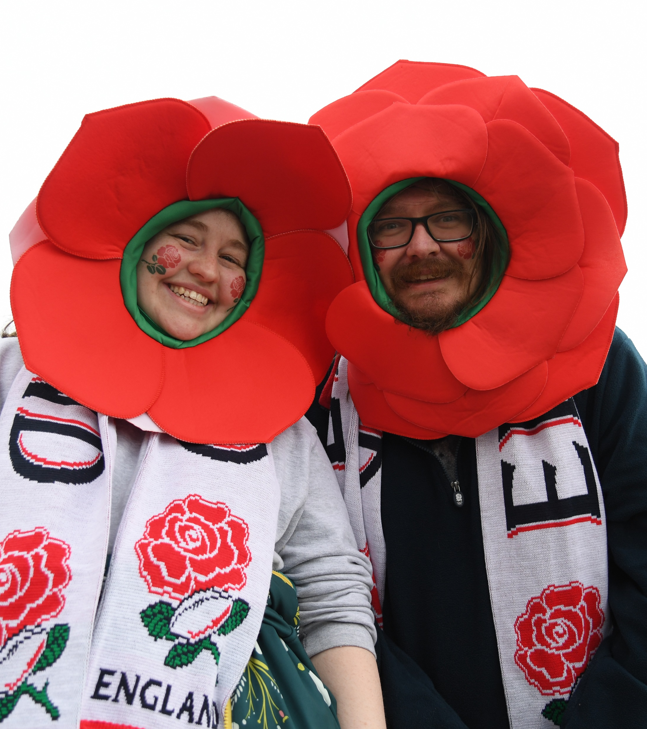
DELIVERING AGAINST YOUR OBJECTIVES
Our packages are built with your objectives in mind. Designed to deliver return on investment, return on objectives or both.
Whatever your needs, we can build a solution to address them.
INCREASE
AWARENESS
SECURE NEW CLIENTS
ENTERTAIN CURRENT & NEW CLIENTS
PROMOTE YOUR PRODUCTS & SERVICES
SUPPORT JUNIOR GRASSROOTS RUGBY
SUPPORT YOUR COMMUNIITIES HEALTH AND WELLBEING
To learn more and set up a meeting, please contact:
Name, Phone Number and Email
Subject to your research on your potential sponsor, you can adapt these objectives.
Think about who they are looking to target and what they are looking to achieve.
Insert your contact details.

