Slide 1
Introduction
These templates have been developed to support the sponsorship sales process and to aid your conversations with potential sponsors.
We have developed a suite of four documents, which can be used as templates for all of your sales collateral including presentations for meetings.
As outlined in the Sponsorship Toolkit, companies engage in sponsorship for a number of reasons and business objectives. Fundamentally, these fall into two categories:
Business to consumer (B2C) – i.e. reaching consumers and increasing awareness and sales/customer numbers (for example). Typical sponsors in these areas will be local retailers, restaurants, coffee shops, hairdressers, gyms and pubs
Business to business (B2B)– i.e. reaching businesses to increase a client base (for example). Typical sponsors include: banks/financial service providers, lawyers and accountants etc.
Therefore, we have created four documents, as follows:
A B2C Sponsorship Teaser, which can be used to make initial contact with potential sponsors and encourage them to have a further conversation or even a meeting
A B2C Sponsorship Deck, which can be used in first meetings, having sent through the teaser to secure a meeting. They can also be emailed after meetings to summarise the opportunity and introduce the club
A B2B Sponsorship Teaser, which can be used to make initial contact with potential sponsors and encourage them to have a further conversation or even a meeting
A B2B Sponsorship Deck, which can be used in first meetings, having sent through the teaser to secure a meeting. They can also be emailed after meetings to summarise the opportunity and introduce the club

Slide 2
Sales Decks - General Considerations
N.B. These recommendations apply to both B2C and B2B decks.
Once you have secured a meeting with a potential sponsor it will be necessary to create an introductory presentation (Sales Deck), which should be more detailed then teaser and provide clear information about your club and the opportunity.
Whilst more detailed than a teaser, the first meeting should be used to listen to the potential sponsor as well as tell them more, so don’t pack the presentation with too much information – use the template to get the right balance!
The comments in the light-blue in boxes provide further information what to think about in creating a deck.
Key Recommendations:
The template has been created for you to pick appropriate slides from a board base and, ideally, a sales deck should not be any longer than 15 slides – so delete the slides that are not appropriate to your club to get the numbers down
As with the teaser the decks should still be visually stimulating, even if there are more slides and more information included, so think carefully about the use of appropriate imagery (see previous slide)
You can use the deck as a guide/agenda for the meeting – you don’t need to ram it full of copy and just read it to the potential sponsor, so…
Practice presenting the deck so you get used to it and ensure that you clearly and concisely get your messages across
Use the Sponsorship Toolkit as a guide to how to make first meetings effective
In the meeting, allow for time to ask the potential sponsor about the objectives, so that you can build a highly relevant package of benefits
At this stage, you don't need to the fee but be prepared to verbally give a ballpark. The final fee will be based on the final package of benefits, which will be based on the objectives of the sponsor

Slide 3
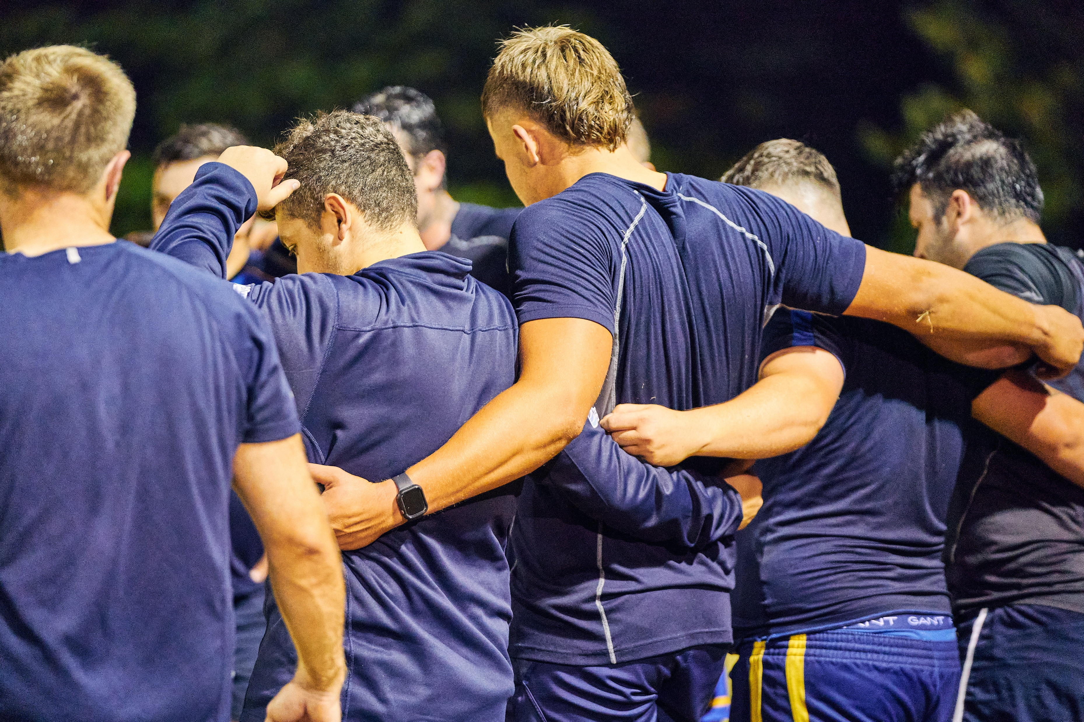
COMMERCIAL PARTNERSHIPS 23/24
JOIN US AT THE HEART OF THE COMMUNITY
Insert Club Logo
Here
(INSERT CLUB NAME)
Insert Potential Sponsor Logo Here
INSERT IMAGE TO FILL THE PAGE WITH THE TEXT IN FRONT.
CONSIDERATIONS: Catch the essence of the club, so show success or a large number of fans watching or something community based.

Slide 4
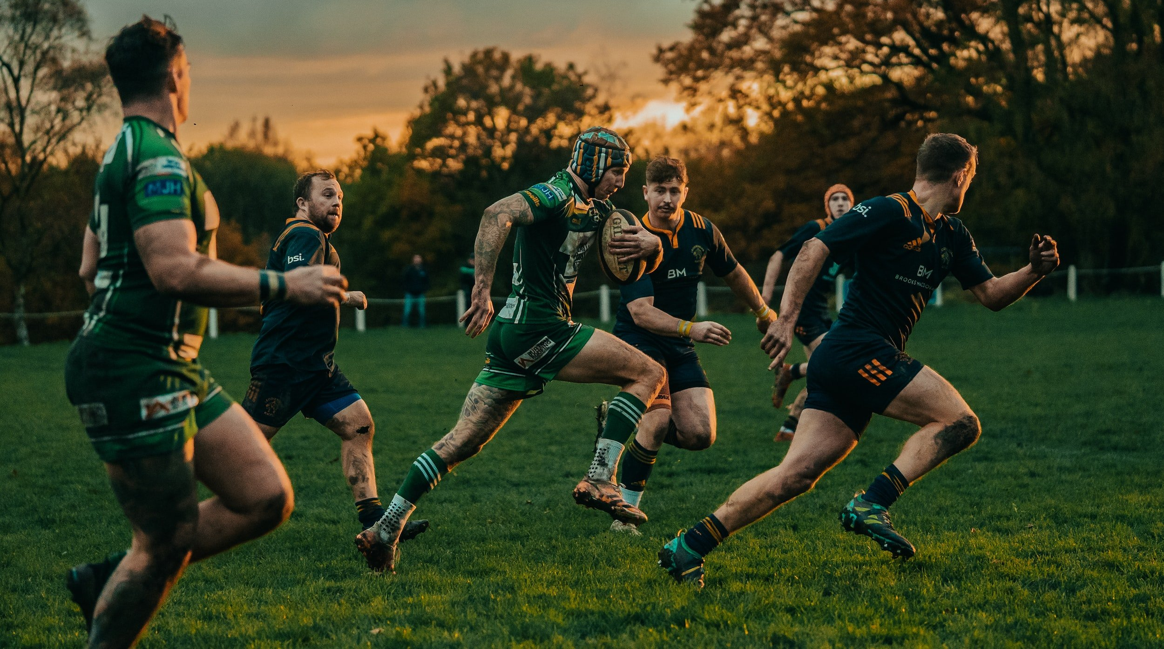
EVERY WEEK, OVER 300 LOYAL FANS, INCLUDING BUSINESSES, WATCH OUR MEN’S 1st TEAM
Change the image and copy as appropriate

Slide 5
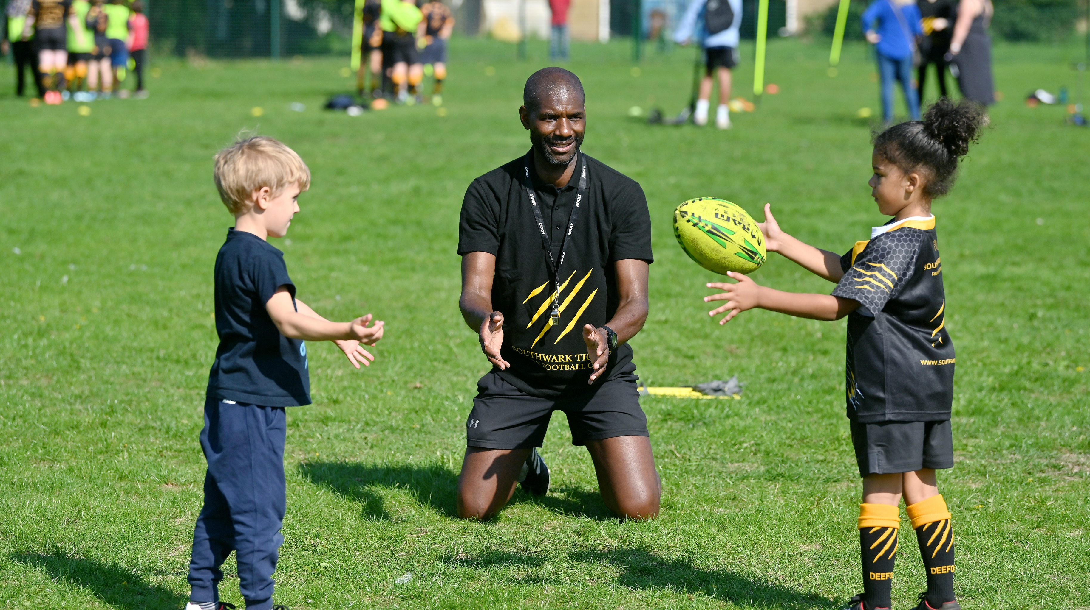
Change the image and copy as appropriate
OVER 700 KIDS AND THEIR PARENTS VISIT THE CLUB EVERY SUNDAY

Slide 6
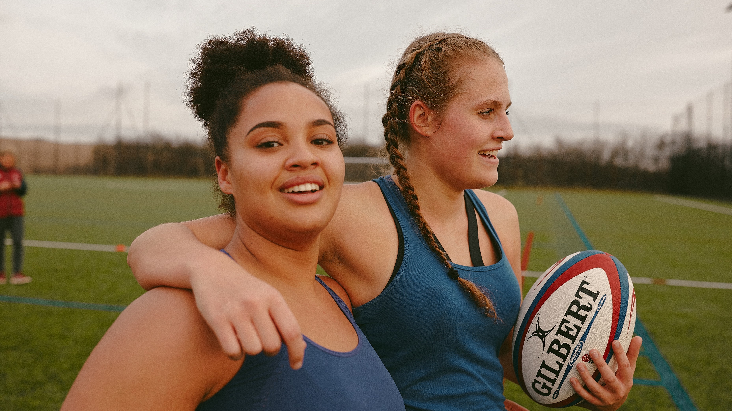
Change the image and copy as appropriate
A FAST GROWING WOMEN’S SECTION INCREASING AT 50% EVERY SEASON

Slide 7
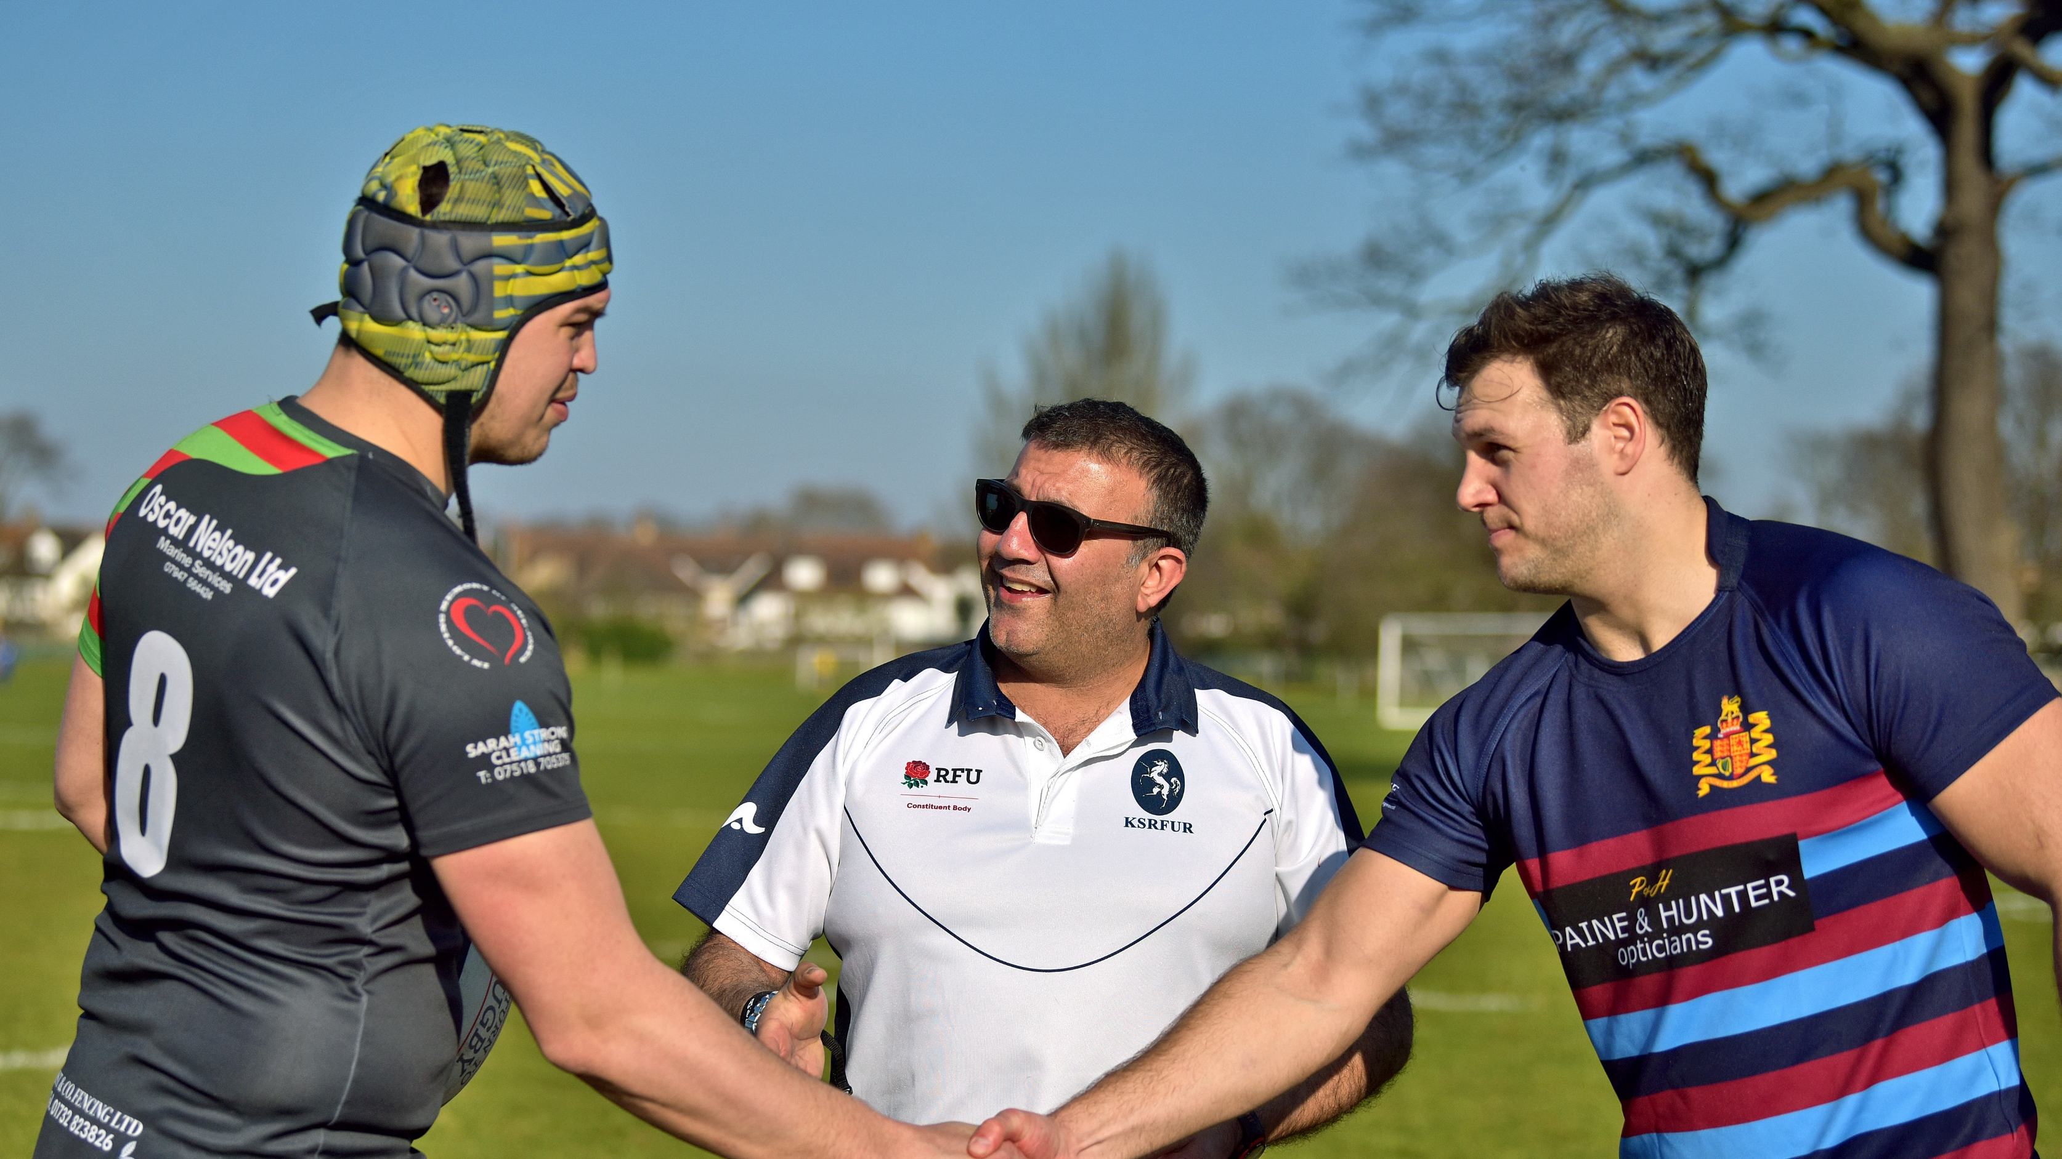
A GROWING NUMBER OF VOLUNTEERS, INCLUDING FROM LOCAL BUSINESSES
Change the image and copy as appropriate

Slide 8
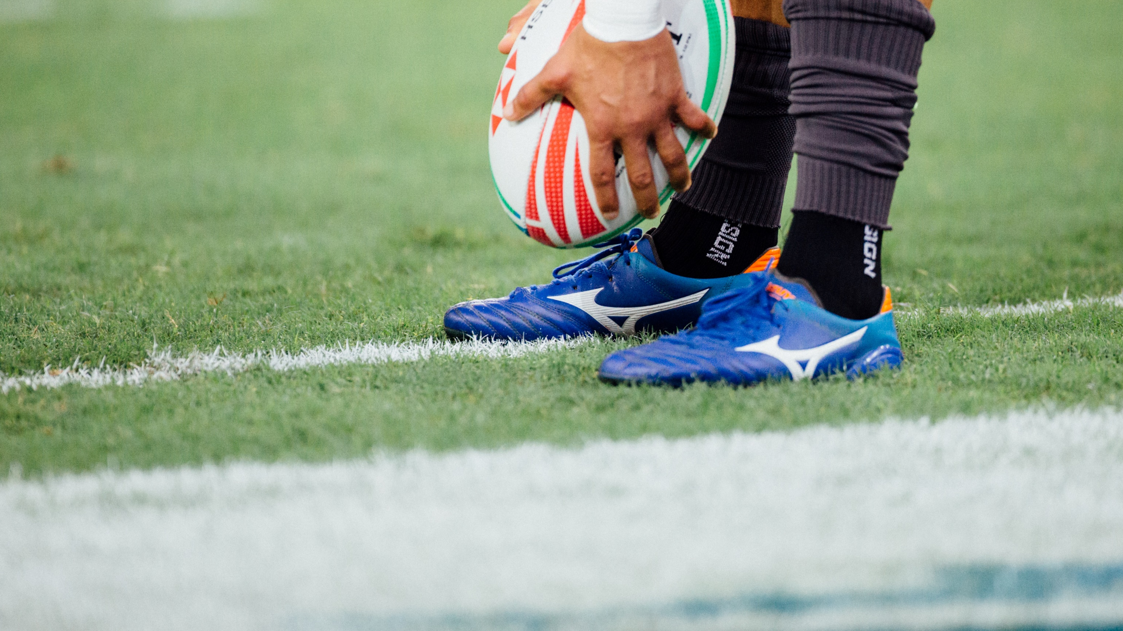
Change the image and copy as appropriate
PLAYING IN THE 3RD TIER OF THE ENGLISH RUGBY PYRAMID, WE ARE A CLUB FOCUSED ON DELIVERING RESULTS BOTH ON AND OFF THE FIELD

Slide 9
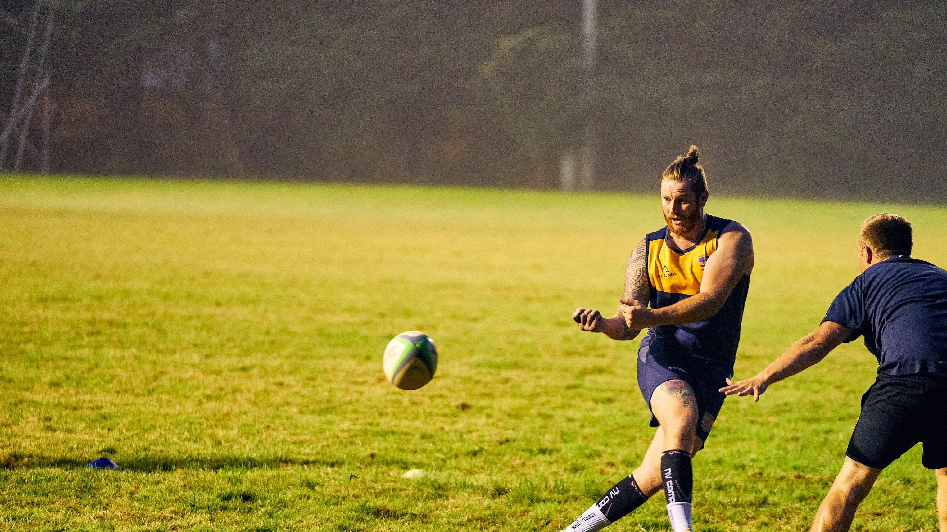
OUR AMBITION IS TO WORK WITH MAJOR BRANDS IN THE AREA WHO SHARE OUR VISION AND HELP GIVE THE COMMUNITY SOMETHING TO BE PROUD OF
Change the image and copy as appropriate

Slide 10
STEEPED IN SUCCESS
CONSIDERATION: Use a relevant image of club success, whether that’s winning a cup, winning a match, getting promoted or staying in the league!
A PROUD HISTORY

Slide 11
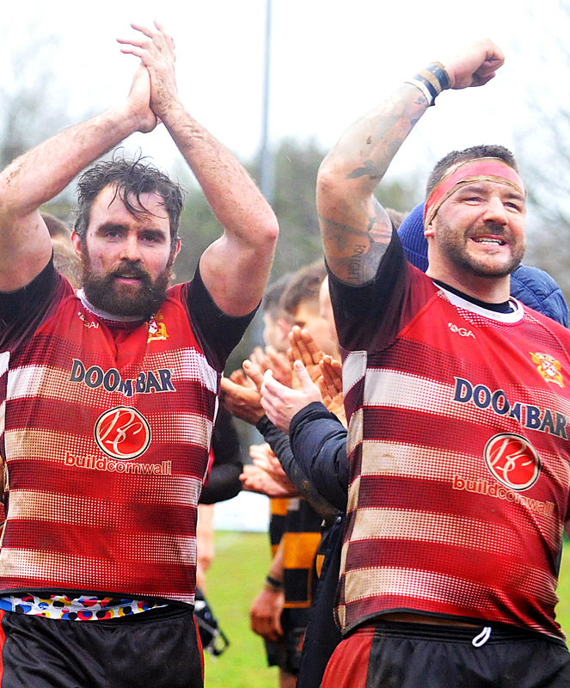
OUR HISTORY & SUCCESSES
Founded in 1874, the oldest sports club in the County
Formed by the local cricket club to keep players active in the Winter
Played in the top flight for 3 years 1989-1992
Been in National League 1 since 2010
County Champions 17 times
Played at Twickenham, the home of rugby, in 1983 and 1988
Club hired out 80 times per annum for local community events
5,000 attendees at our Annual Firework Display
The club is regularly used by the NHS as a clinic
A steadily growing membership base
Think about the key milestones of the club and interesting stories. Try and limit this to 5 or 6 key stories……these are examples:
Change the image as appropriate to reflect club success.

Slide 12
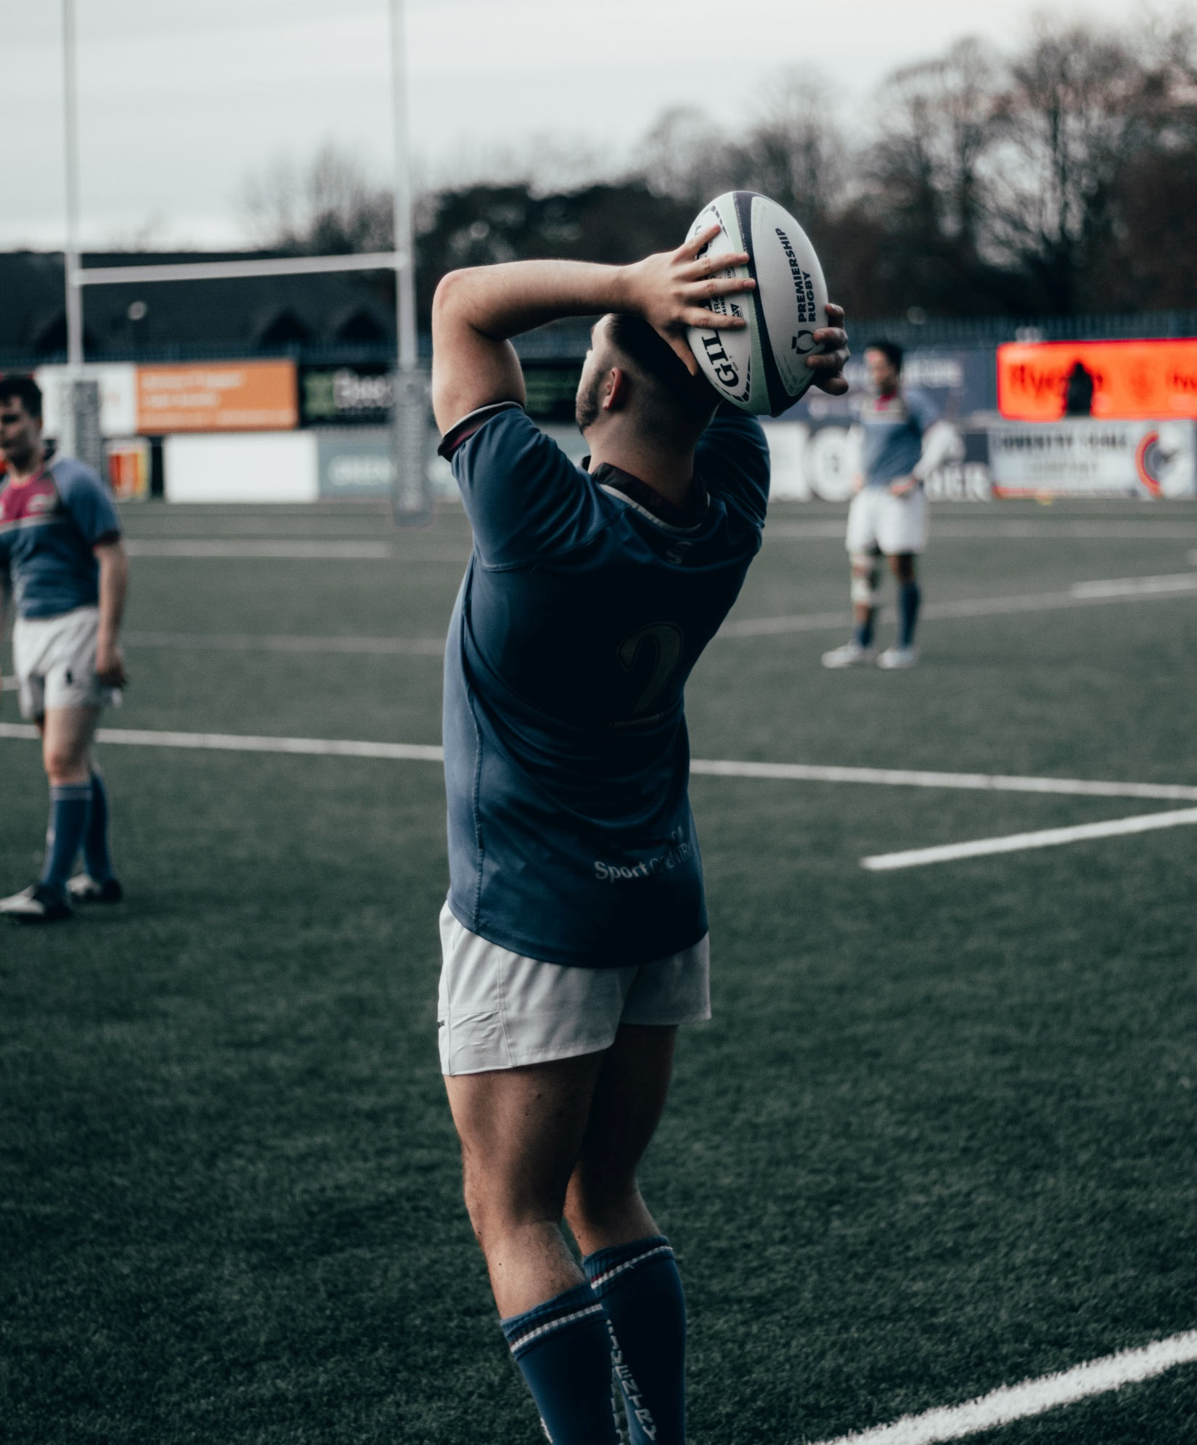
SOME OF OUR FORMER LEGENDS
Paul Ackford – England
Danny Cipriani – England
Andy Ripley – England
Martin Offiah – England (Rugby League)
Alex King – England
Joe Launchbury – England
List your well-known players. The following are examples(potentially add images, if you have good ones).
The legends don’t have to necessarily be famous rugby players. They could be local business people or celebrities in other fields.
SPACE FOR EX-PLAYER IMAGES - N.B. DO GIVE CONSIDERATION TO WHO OWNS THE RIGHTS TO THESE IMAGES

Slide 13
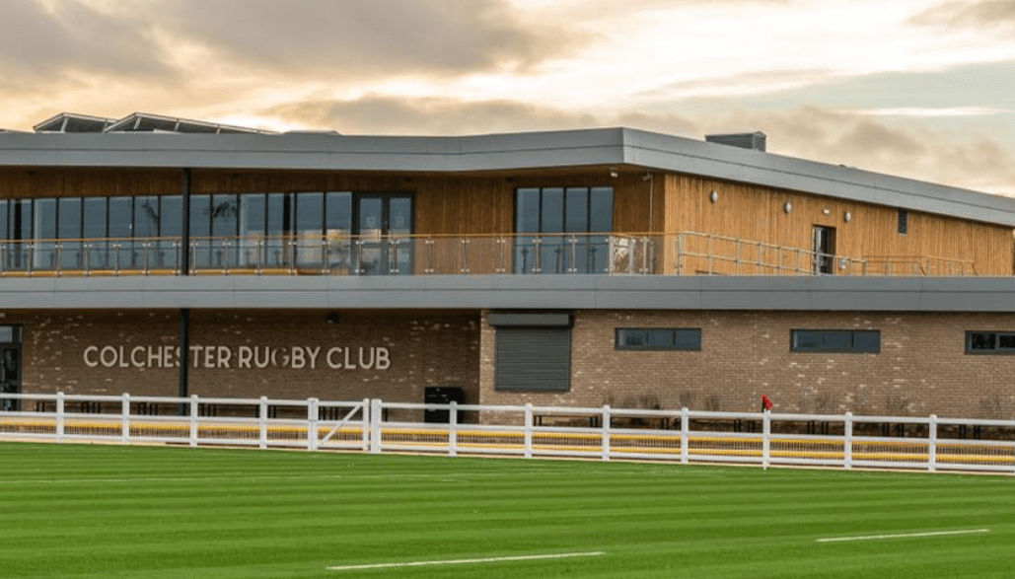
TODAY AND THE FUTURE
A COMMUNITY HUB
CONSIDERATION: Use a relevant modern picture of the club to demonstrate the focus for today and the future.

Slide 14
Tailor this slide to outline your local community commitment…..
A CLUB AT THE HEART OF THE COMMUNITY
We are a growing club who now have 5 men’s teams, a woman’s team, 3 colts teams and junior teams of boys and girls between the ages of 6 and 17. We use the values of rugby to engage with the the local business community.

Slide 15
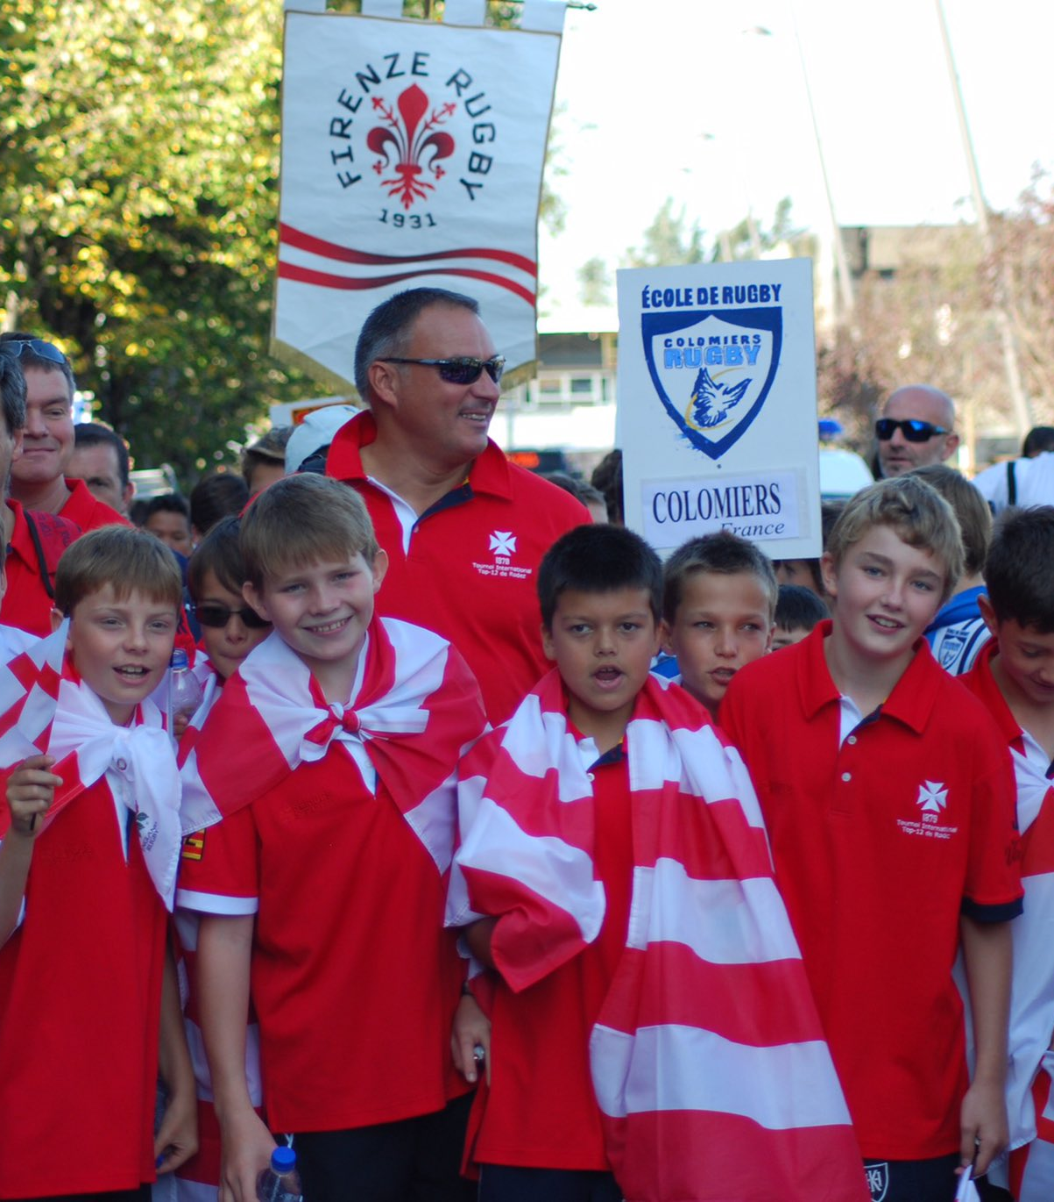
OUR ROLE IN THE COMMUNITY
9 Community Coaches
17 Partner Schools
6 Grants Awarded
3 Active Special Needs Projects
Average of 77 children play per day at HAF camps
712 Hours of coaching delivered September-December
If possible, create an info-graphic to capture the links and work you do in the community (Example data taken from Rosslyn Park)
583 Children Coached weekly in schools
700+ Children impacted by our coaching each week
22 Local schools have used The Rock for sport
Insert relevant picture of work in the community

Slide 16
THE CLUB IS BUILT ON OUR CORE VALUES
OUR MISSION, OBJECTIVES AND PROMISE
TEAMWORK
OUR MISSION
Be a club the whole community can be proud of
RESPECT
ENJOYMENT
OUR OBJECTIVES
Perform on the pitch – Maintain our league status
Increase fan base and match attendance
Maintain mini numbers and develop stars of the future
Build the best women’s team in the south
Partner with the best companies in the area
DISCIPLINE
SPORTSMANSHIP
OUR PROMISE
A club focused on ensuring that the local community is at the heart of everything that we do.
This means delivering for players, staff, fans, locals and, crucially, sponsors
Complete based on your own clubs’ aspirations – these are examples

Slide 17
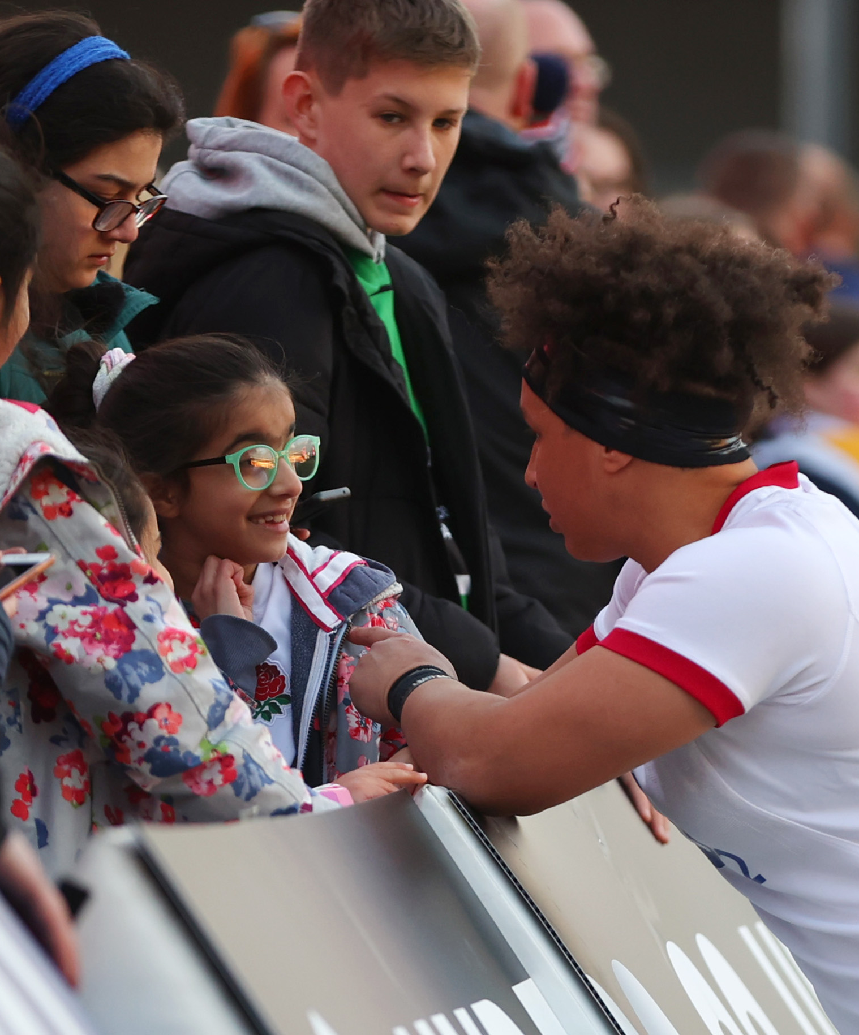
OUR MEMBERS AND PLAYERS
Home games in <XXXXXX>
Capacity of <XXXX>
1st team playing in XXXX League, the XXX tier of English rugby
100 players across 5 men’s teams
A squad of xxx in our Women’s Team
Over 1,000 under 18 boys and girls and 75 in the colts section
Over XXXX social/spectating members
Complete the following as appropriate.
Include appropriate image

Slide 18
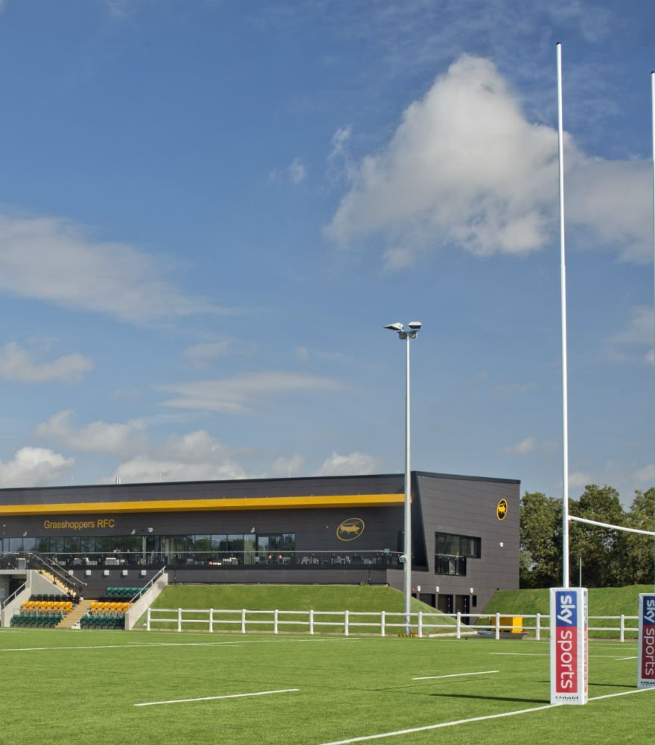
OUR HOME – <GROUND NAME>
Our home since XXXX
XXXX Capacity
XXX mins from <major city>, with regular trains from <Station>
An environment for the whole family
On-site bar and clubhouse
Exclusive VIP/Hospitality Area
A new Masterplan for the future, bringing us a new club house and floodlights
Complete the following as appropriate.
Include appropriate image

Slide 19
COMMERCIAL PARTNERSHIPS 23/24
EXAMPLES OF MEDIA & MARKETING COVERAGE
Add examples of press coverage, including league tables and articles

Slide 20
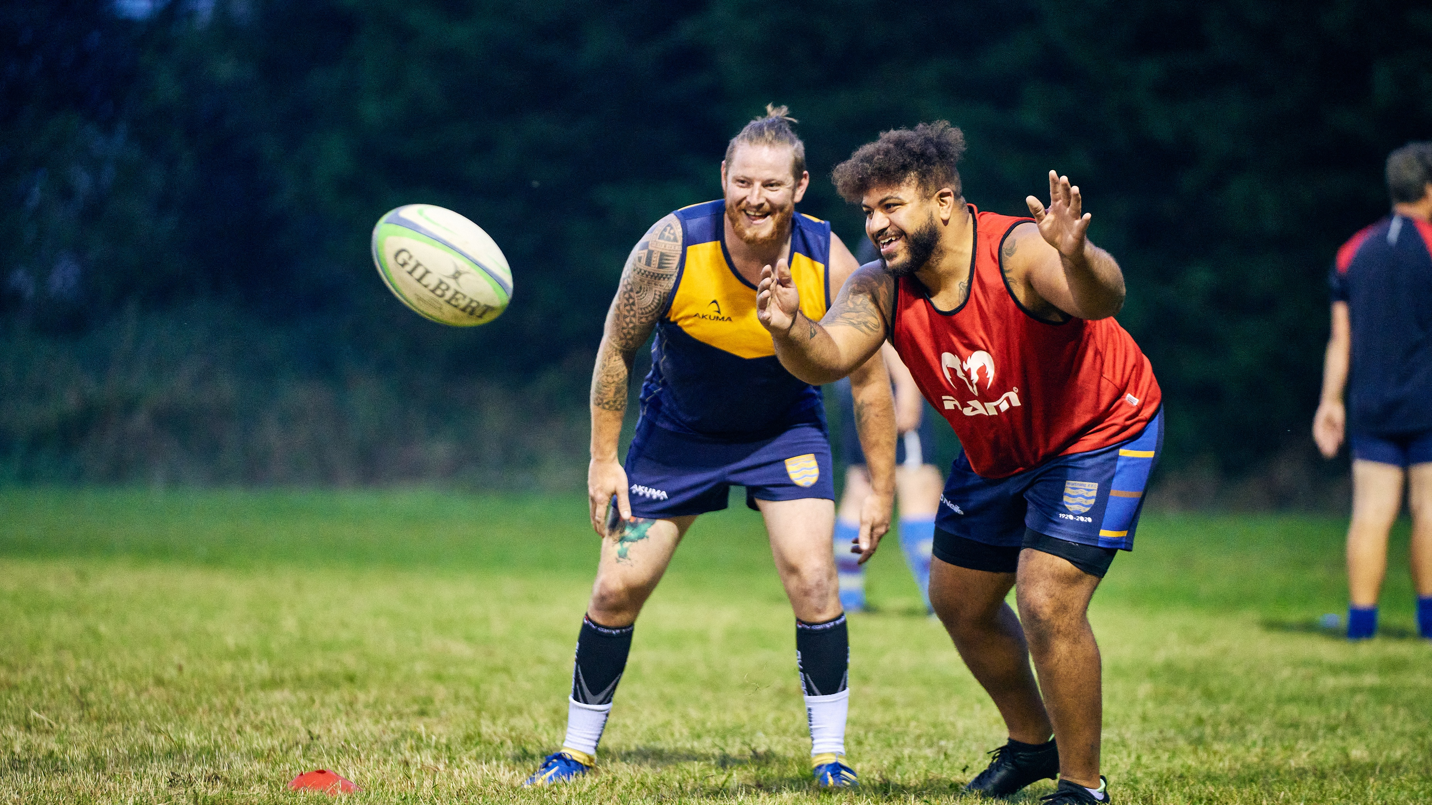
WORKING WITH US
THE SPONSORSHIP OPPORTUNITY
Change the image as appropriate.

Slide 21
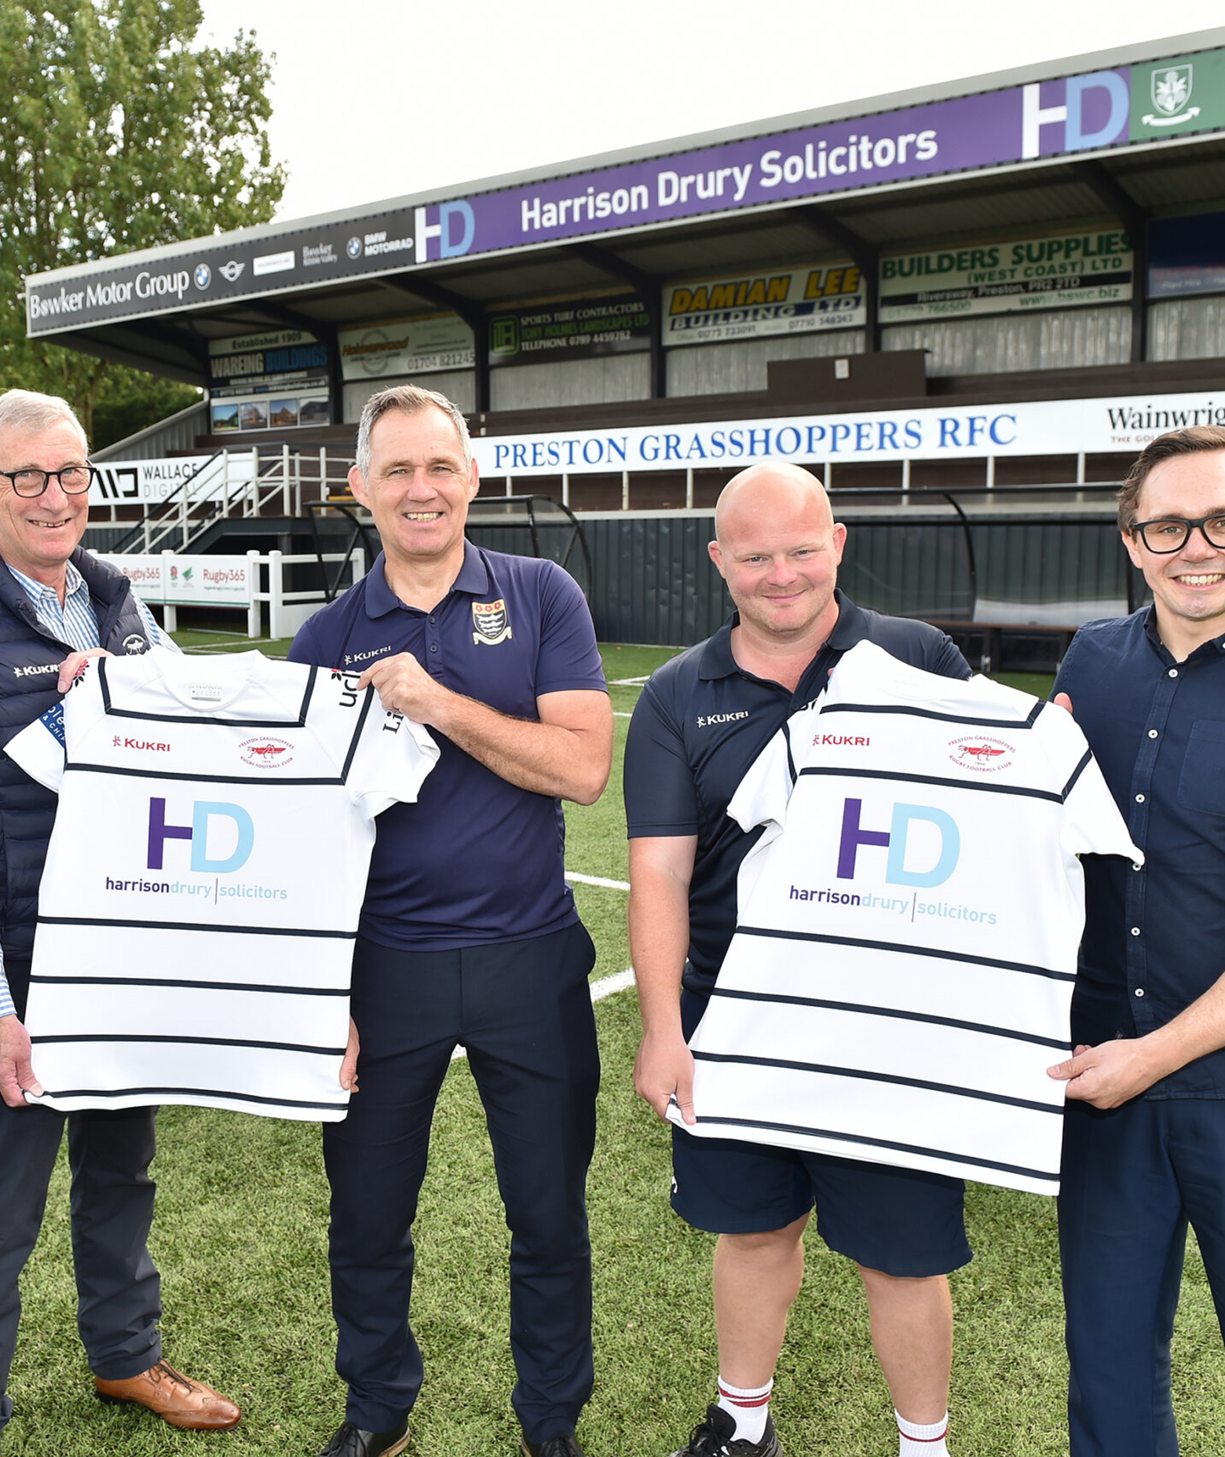
WHAT WE CAN DO FOR YOU
We are a club who’s at the heart of your local community.
We are a club who respect local businesses and want to enhance the region as a centre for commerce.
We are looking to work with businesses who share the same vision, in terms of being driven by performance and becoming ambassadors for the area.
We can build a sponsorship that will really deliver against your short, medium and long-term objectives.
Consider who you’re meeting and whether they share the same values as you, especially across the community etc.
Include appropriate image

Slide 22
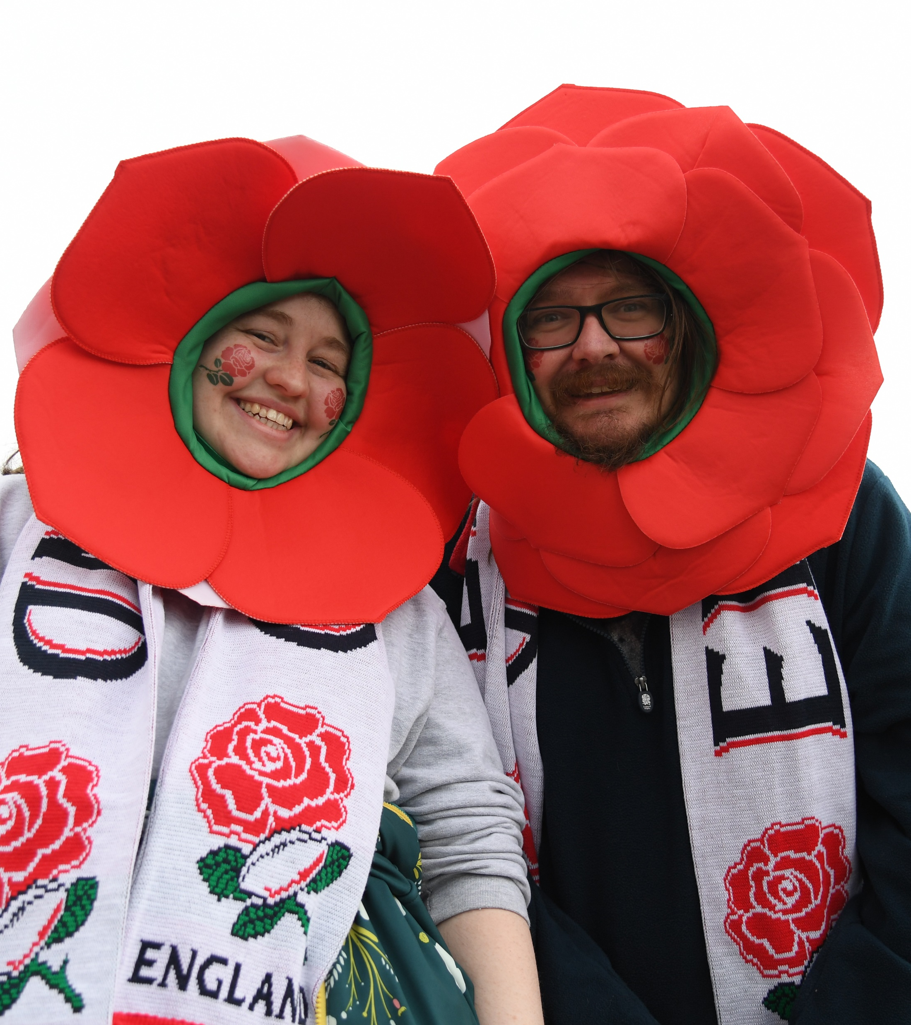
DELIVERING AGAINST YOUR OBJECTIVES
Our packages are built with your objectives in mind. Designed to deliver return on investment, return on objectives or both.
Whatever your needs, we can build a solution to address them.
INCREASE
AWARENESS
SECURE NEW CLIENTS
ENTERTAIN CURRENT & NEW CLIENTS
PROMOTE YOUR PRODUCTS & SERVICES
SUPPORT JUNIOR GRASSROOTS RUGBY
SUPPORT YOUR COMMUNIITIES HEALTH AND WELLBEING
Subject to your research on your potential sponsor, you can adapt these objectives.
Think about who they are looking to target and what they are looking to achieve.

Slide 23
SPONSORSHIP BENEFITS
Official Sponsor of <CLUB> Status
Exclusivity e.g. Only accountancy firm
Branding Back of shirt on all club playing shirts
6 tickets to every game, plus a free pint
Invitations to pre-match lunches on 4 occasions (with 3 guests)
A table at the End of Season Dinner
Branding 6 x perimeter boards (4 near the half way line [both sides] and 2 at each end behind post)
Inclusion in our newsletter, sent to all players and members (including mini’s parents)
Branding on the sponsors’ board in the club house
Accreditation in social media 1 guaranteed post each month
An exhibition stand at every home game
Sponsor and have access to our Business Club
Use of the club house for meetings/events on 2 occasions per season
Branding on the website, plus 200 word summary of your business
The right to undertake sales promotions i.e. discounts for club members
Branding in all match day team sheets
The opportunity to host drinks networking events for your own guests at the club
Access to players and coaches for your own B2B events
Attend sponsor events, including the Annual Golf Day (up to 4 people)
Adjust benefits based on the base package you’ve developed, but add appropriate extras to suit the objectives of the business you’re meeting.
N.B. These benefits are examples
AT THIS EARLY STAGE THERE IS NO NEED TO INCLUDE A PRICE AS IT WILL BE BASED ON THE FINAL PACKAGE OF BENEFITS….BUT BE PREPARED TO VERBALLY GIVE A BALLPARK , GIVING CONSIDERATION TO THE COST ELEMENT OF DELIVERING BENEFITS. OBVIOUSLY CONSIDER THE COST ELEMENT TO MAKE SURE THAT YOU'RE NOT MAKING A LOSS ON PROVIDING ANY BENEFITS.

Slide 24
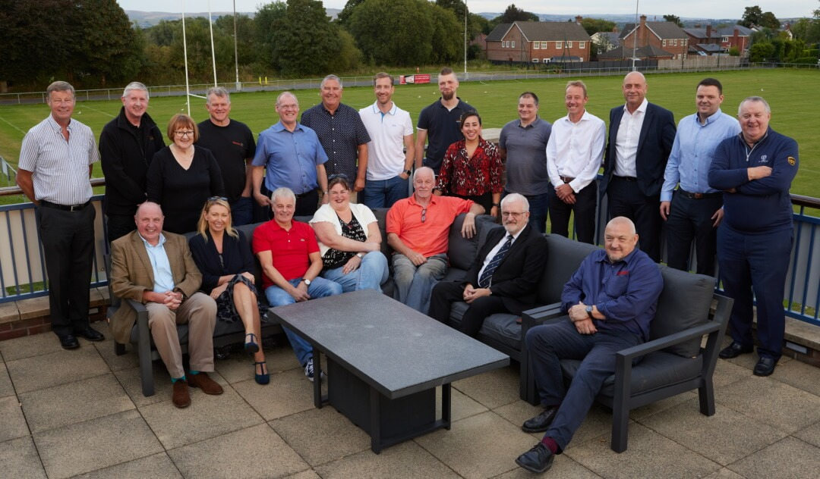
Change the image as appropriate.
JOIN OUR CLUB TO BUILD CONTACTS, NETWORK AND ENHANCE YOUR BUSINESS CREDENTIALS

Slide 25
WHAT HAPPENS NEXT?
Tell us your biggest challenges.
We’ll develop a proposal based on your objectives.
We’ll form a fantastic and longstanding partnership.
Insert your contact details
Include appropriate image

